Slide 1
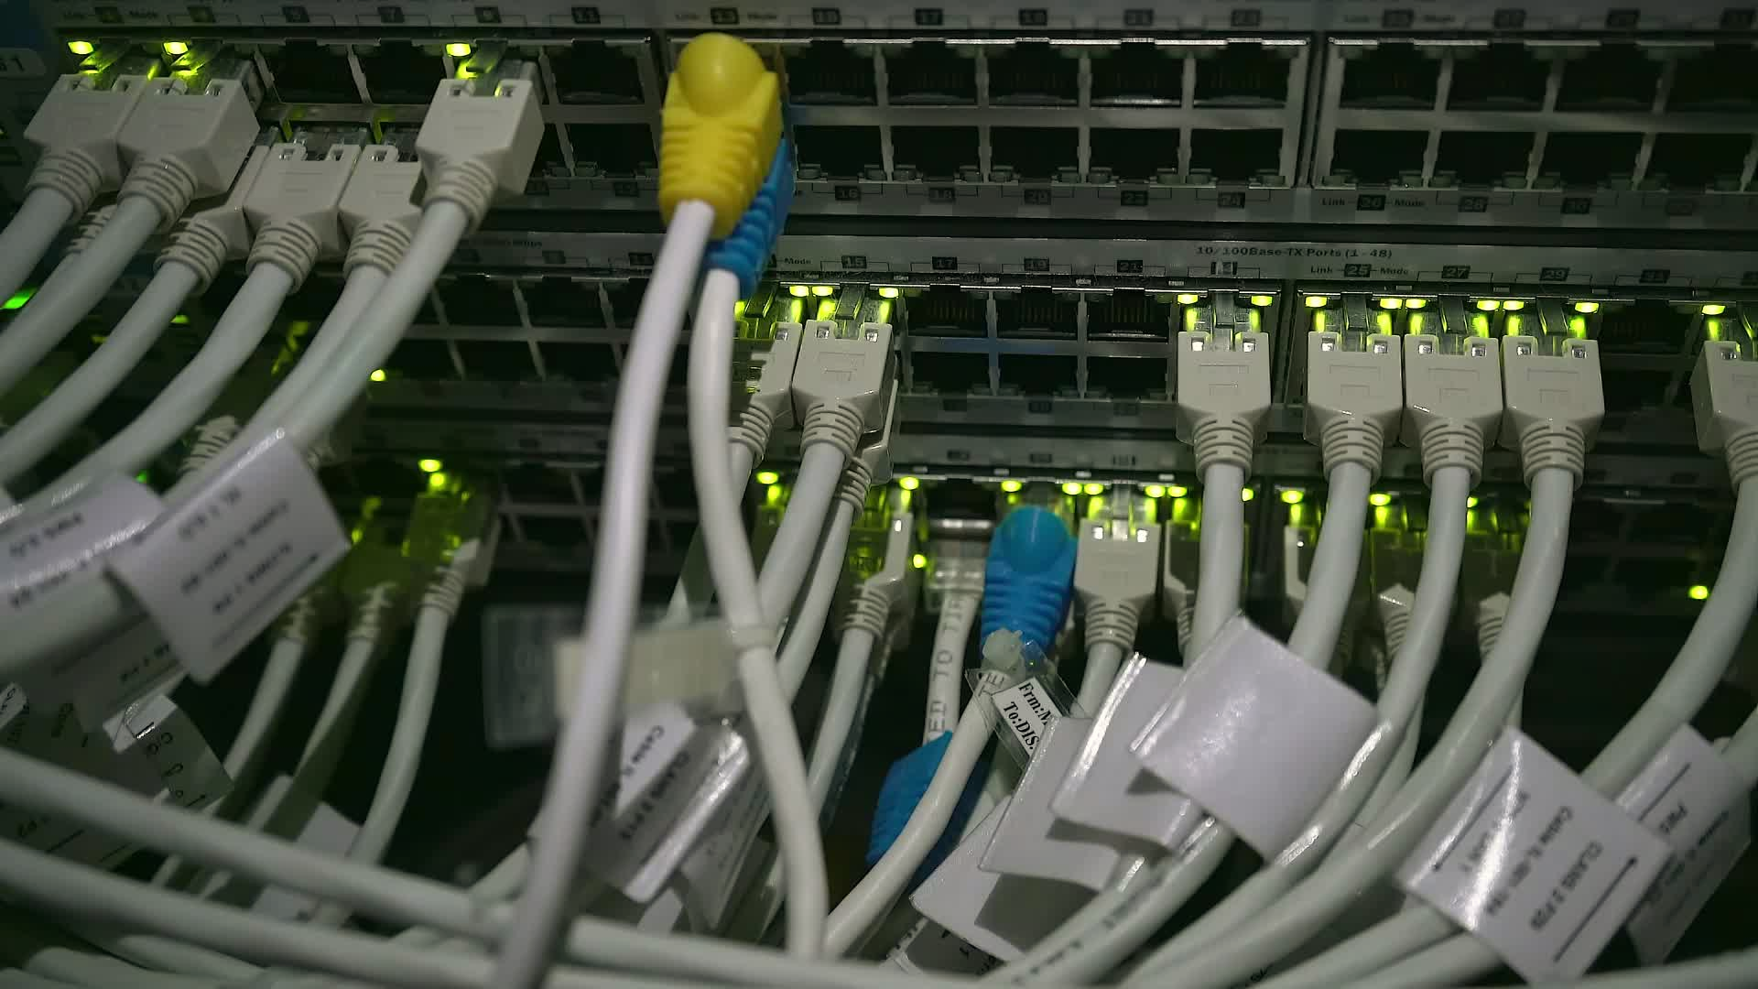
Equipment needed
Windows Laptop
USB Cable
One end with micro-USB connector

Slide 2
Top-level Process
Install Respimatic Firmware Release
Download Respimatic Firmware Release
One-time Download Arduino Builder
One-time Install Arduino Builder

